Slide 1

URSSI Conceptualization Survey
Notes:
One major goal of our year-long conceptualization is to understand the diverse challenges and barriers that researchers face when developing software.
Get more input that we could gather from our i—person workshops
To better understand these challenges, we are currently in the midst of running a large scale survey aimed at researchers who develop or use software, software engineers in academia, government, and other research focused institutes
Hopefully some (or most) of you have taken the survey. If not, I will provide a link at the end
Today, I just want to update you briefly on our current status

Slide 2
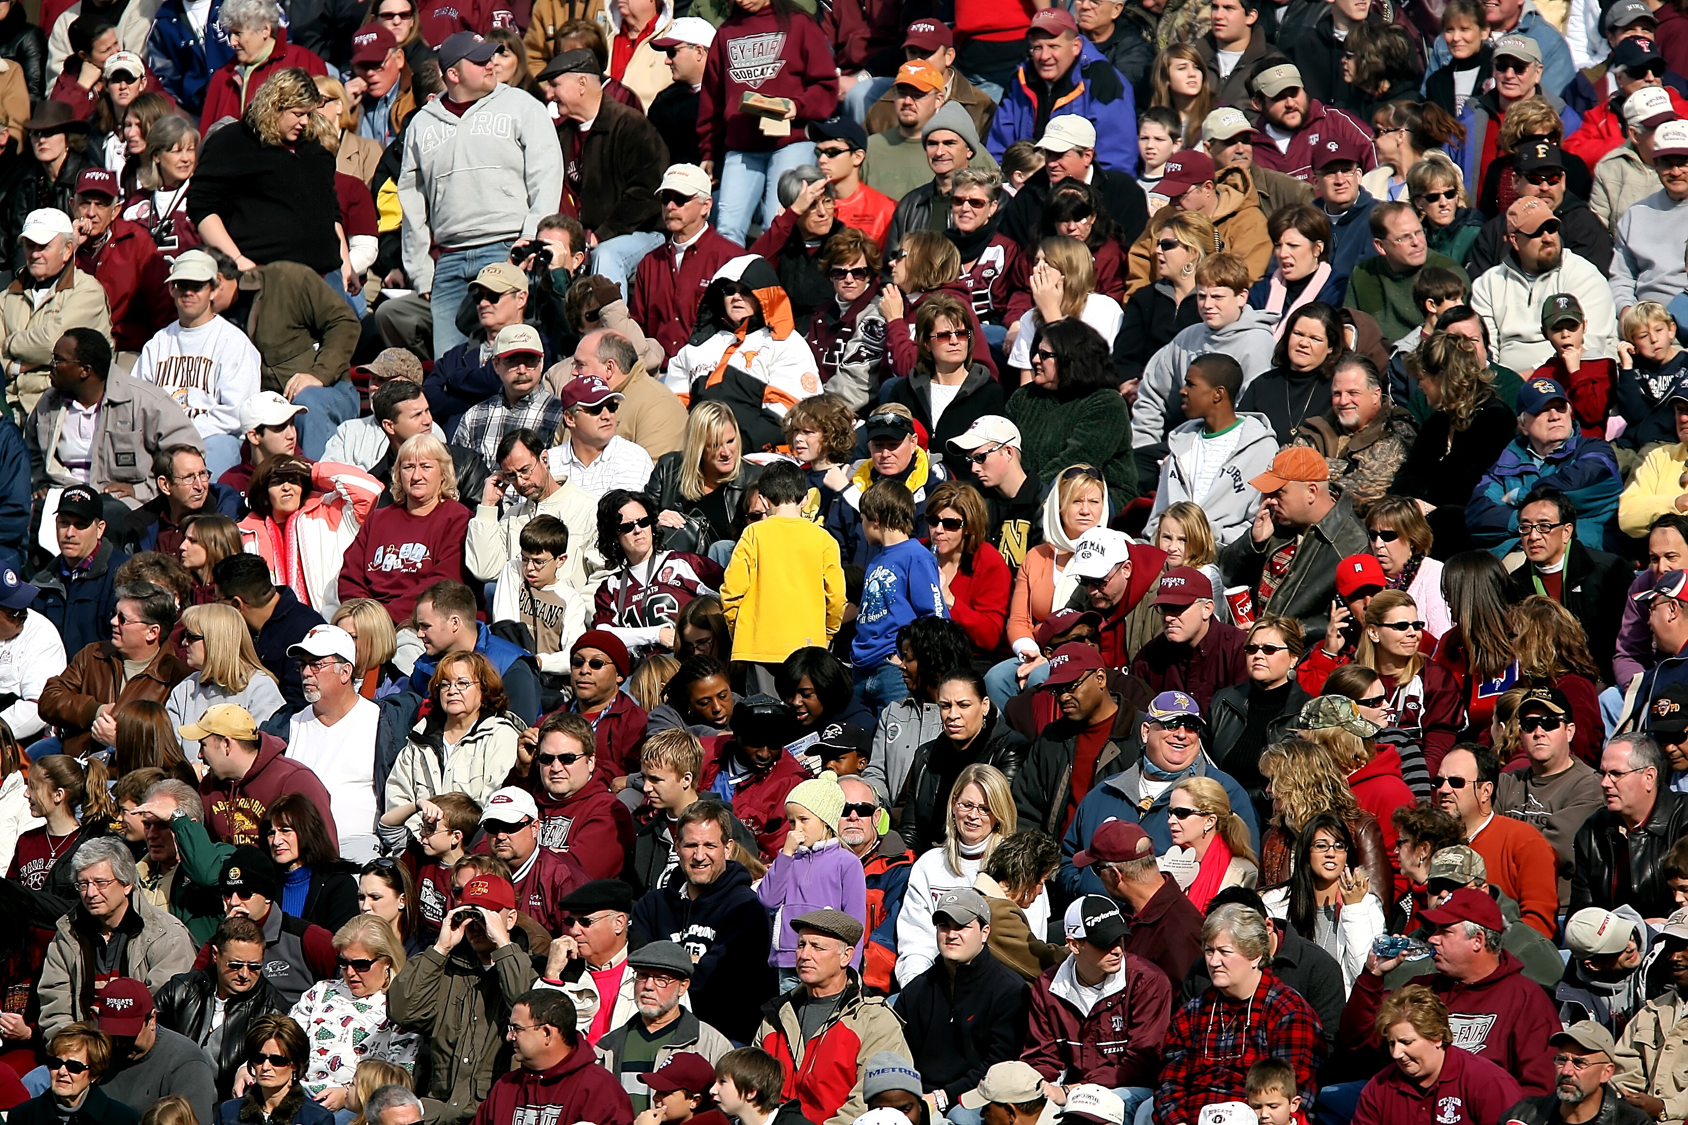
899 Responses
Notes:
Type of respondent
Researcher
Developer
Type of institution
The Professional Title of the respondents was overwhelmingly “Faculty” (513 responses)
Discipline of research performed (not unique)

Slide 3

http://urssi.us/survey
Notes:
If you haven’t taken the survey, please do. Also, please help us distribute it more widely.

Slide 4
Ethnography + URSSI
Chicago Workshop
October 23, 2018
Notes:
I’m an institutional ethnographer …
I’ll say a few words about the conceptual framing of this work and then what it will hopefully contribute to URSSI

Slide 5

Ethnography + URSSI
Ethnographers of institutions are interested in the lived experience of people working together to build and maintain social relations for goal directed work …
We ask:
…How social relations are formed through shared artifacts (e.g.software)
…How shared artifacts structure institutional forms
...How institutional forms are sustained as they adjust to external and internal pressures of maintaining social relations
Notes:
A brief note about insitutions and institutes…
An institution is the set of material practices and symbolic systems including assumptions, values, and beliefs by which individuals or groups of individudals use to provide meaning to their daily activity, organize activities, and reproduce or replicate those activities over time…

Slide 6
Ethnography + URSSI
Infinite and Finite institutional forms… comes from the work of religious scholar James Carse
Finite institutional forms “…use instrumental activities – such as sports or politics - in which the participants obey rules, recognize boundaries and have definitive ends (winners and losers).”
Infinite institutional forms “…use a range of activities to play with boundaries and exists solely for the purpose of continuing the state of the institution.”
Notes:
All institutional forms are not the same… one way to differentiate these is along temporal lines… In particular I like James Carse’s work on …

Slide 7
Ethnography + URSSI
My ethnographic work for URSSI is to observe these two different institutional forms and understand how we might be support their goals and social relations …
Finite institutions that might engage with URSSI
Software is created for specific purpose, for a limited amount of time, to achieve a short-term goal
Examples : RAPID or EAGER awards at NSF (currently observing 2 cases)
Infinite institutions that might engage with URSSI
Software is created for a broad discipline / domain to further a research paradigm, has unique long-term needs to remain accessible and useable within (or beyond) that paradigm
Examples: Other SI2 institutes, Career Awards, Discipline specific ‘platforms’ or infrastructures ( currently observing 1 case)

Slide 8
Ethnography + URSSI
What results from this work can we expect to inform the ultimate design of URSSI?
Description of lived experiences of the three cases under current observation
What are unique challenges to finite vs infinite institutions as they both build and maintain software that is of value to broader scientific community?
Requirements for supporting institutions that struggle with…
Boundaries of sustainability (how to keep work going, how to transition from one form to another, seek formal and informal rules to structure work, etc.)

Slide 9




The Conceptualization of URSSI – Community Engagement and Exchange
Sandra Gesing
sandra.gesing@nd.edu
October 23, 2018

Slide 10
Conceptualization
Workshops
First workshop took place in April in Berkeley
Next workshop takes place now
Software credit workshop
Incubator workshop
Survey
Ethnographic studies
Mission and vision working group

Slide 11
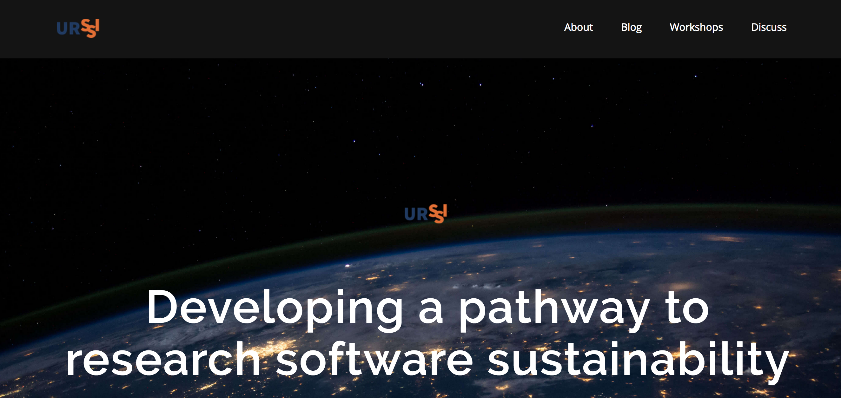
How to Connect
Website http://urssi.us/

Slide 12
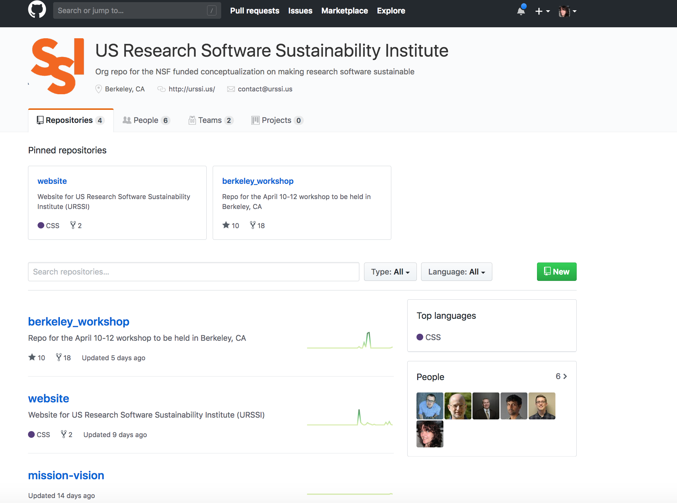
How to Connect
Website http://urssi.us/
Materials https://github.com/si2-urssi

Slide 13

How to Connect
Website http://urssi.us/
Materials https://github.com/si2-urssi
Blog posts http://urssi.us/blog/

Slide 14
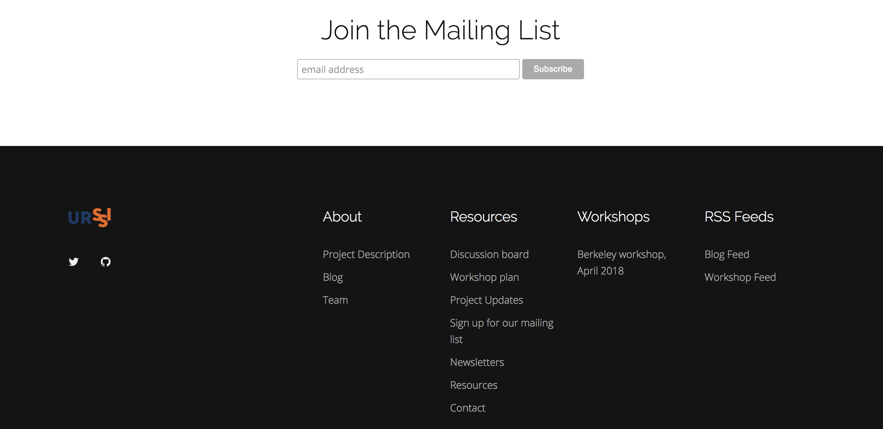
How to Connect
Website http://urssi.us/
Materials https://github.com/si2-urssi
Blog posts http://urssi.us/blog/
Mailing list http://urssi.us/

Slide 15
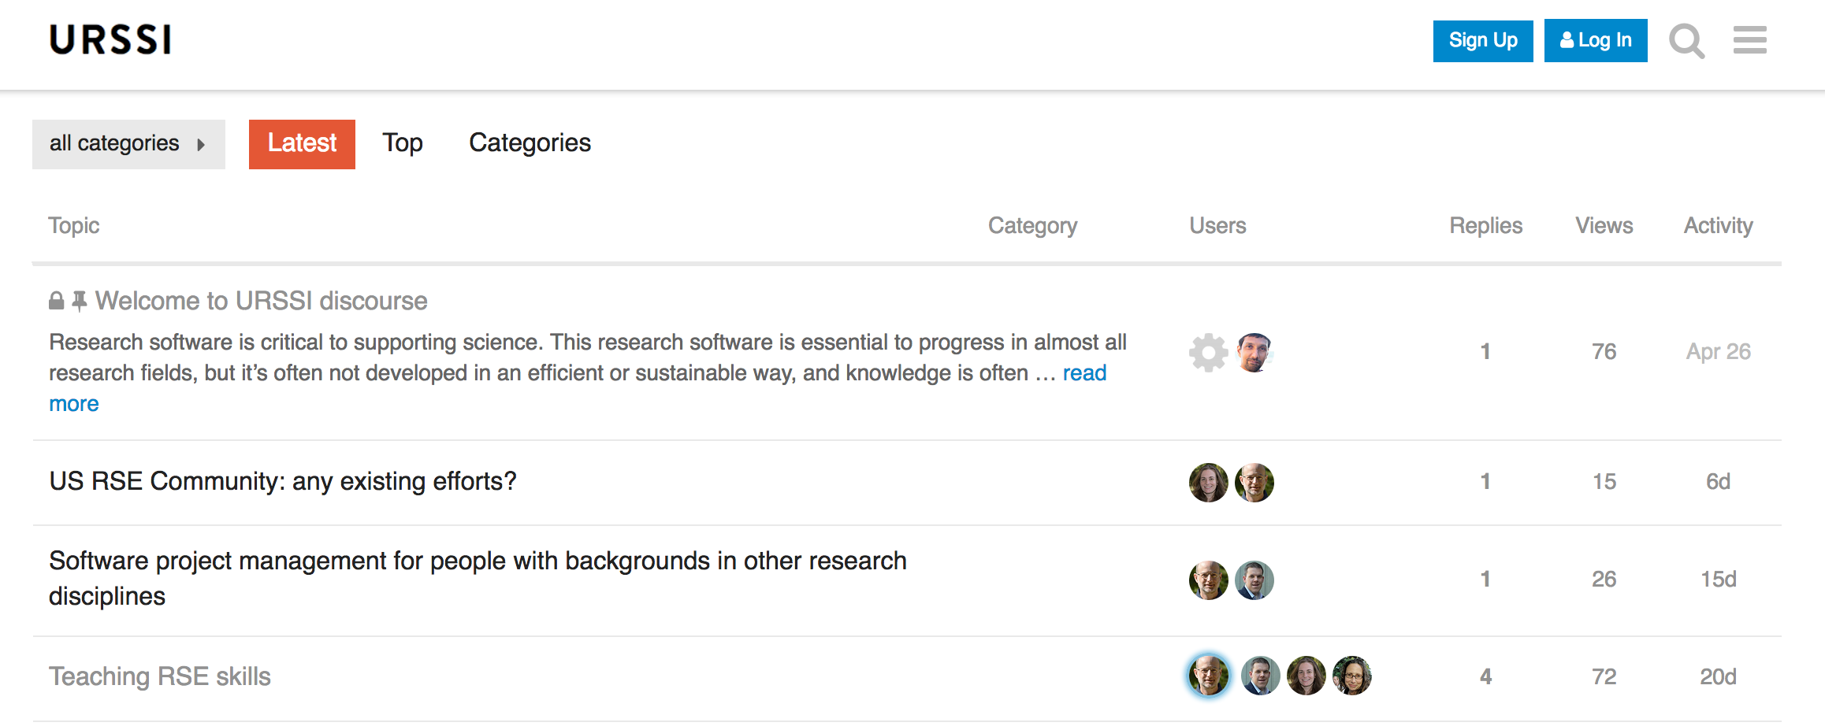
How to Connect
Website http://urssi.us/
Materials https://github.com/si2-urssi
Blog posts http://urssi.us/blog/
Mailing list http://urssi.us/
Discuss https://discuss.urssi.us/

Slide 16
How to Connect
Website http://urssi.us/
Materials https://github.com/si2-urssi
Blog posts http://urssi.us/blog/
Mailing list http://urssi.us/
Discuss https://discuss.urssi.us/
Twitter https://twitter.com/si2urssi

Slide 17
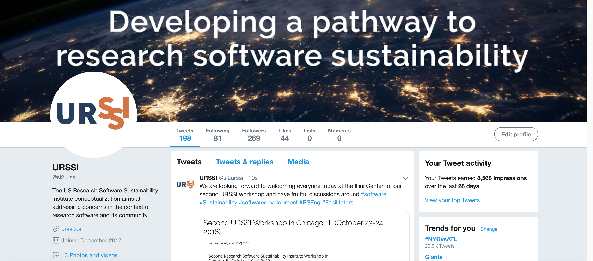
How to Connect
Website http://urssi.us/
Materials https://github.com/si2-urssi
Blog posts http://urssi.us/blog/
Mailing list http://urssi.us/
Discuss https://discuss.urssi.us/
Twitter https://twitter.com/si2urssi

Slide 18
Thanks!
Website http://urssi.us/
Materials https://github.com/si2-urssi
Blog posts http://urssi.us/blog/
Mailing list http://urssi.us/
Discuss https://discuss.urssi.us/
Twitter https://twitter.com/si2urssi
Workshops http://urssi.us/workshops/
Please join us forming a vision for the implementation of URSSI!
We are also happy to give presentations at your events!

